Slide 1

Audible Case Study
Mentor: Ayushi Jain
Presented by: Sapna Bhambhwani
Presented by: Sapna Bhambhwani

Slide 2

Problem: Standardize the name column to ensure consistent title casing.
Solution:
The Name column has been reviewed and is already in title case, ensuring consistent formatting across all entries. No further transformation is required.
linkedin.com/in/sapna-bhambhwani

Slide 3
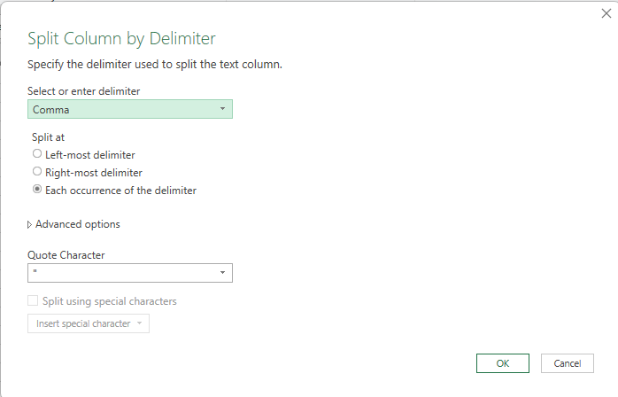

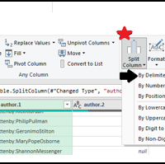
Problem: Separate combined names in the author column if there are multiple authors.
Solution:
Applied the "Split Column by Delimiter" transformation in Power Query to divide combined author names into separate columns. This ensures each author is treated as an individual entity for accurate analysis, filtering, and reporting.
linkedin.com/in/sapna-bhambhwani

Slide 4

Problem: Ensure all entries in the releasedate column follow a consistent date format (DD-MM-YYYY).
Solution: The ReleaseDate column has been reviewed and all entries are already standardized to the DD-MM-YYYY format, ensuring consistency across the dataset. No further transformation is required.
linkedin.com/in/sapna-bhambhwani

Slide 5
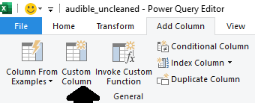
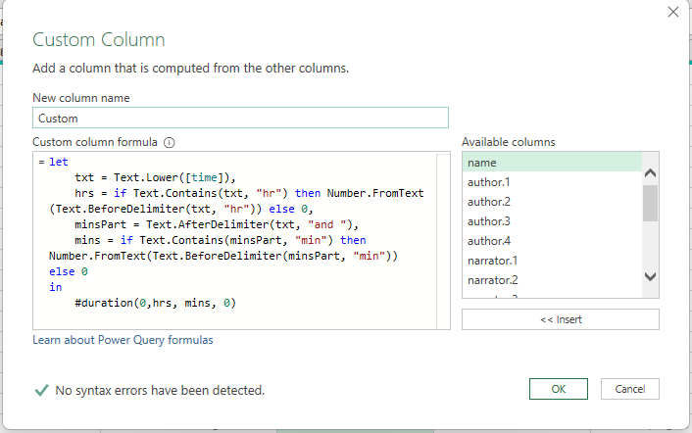
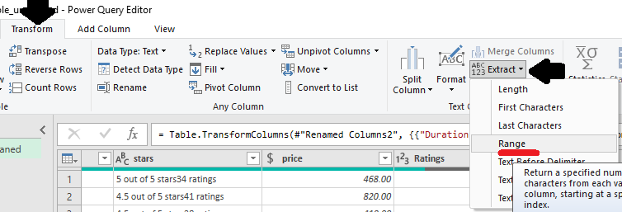
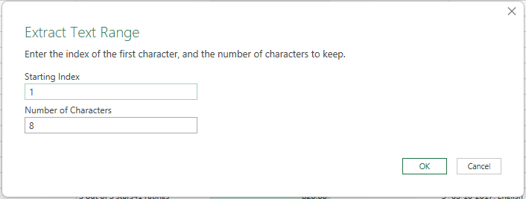
Problem: Convert the time column from text format to a duration format that Excel recognizes.
Solution:
Added a Custom Column in Power Query using an M query formula to convert the text into a recognizable duration format.
After conversion, used the "Extract Range" option to retrieve the time in hh:mm:ss format, allowing proper time calculations, filtering, and visualizations.
linkedin.com/in/sapna-bhambhwani

Slide 6
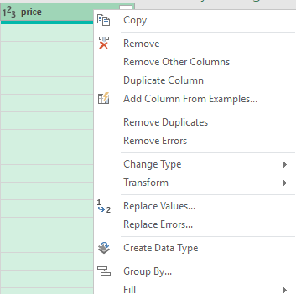

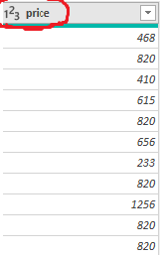
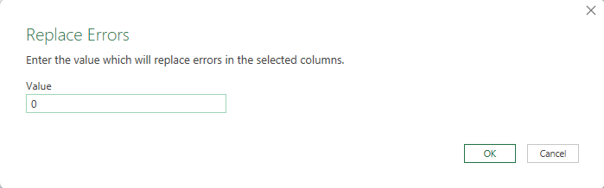
Problem: Ensure the price column is in a numeric format and identify any non-numeric values.
Solution:
The column is already in numeric format; however, it was generating errors. To ensure smooth calculations, all error values were replaced with 0."
linkedin.com/in/sapna-bhambhwani

Slide 7

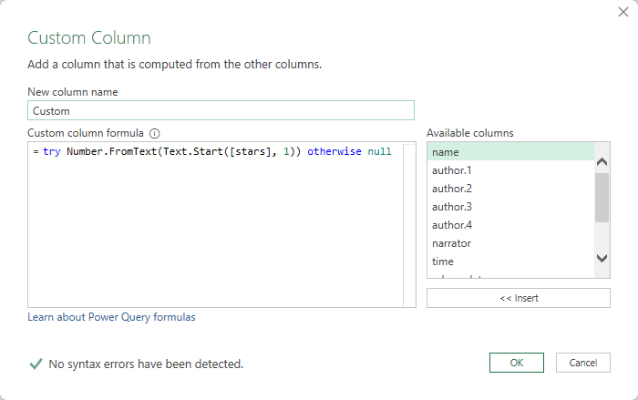
Problem: Convert text ratings in the star's column to numeric values.
Solution:
Created a new custom column using the M query
Ratings = try Number.FromText(Text.Start([stars], 1)) otherwise null.
Then, changed the data type to Number and renamed the column to Ratings for clarity and consistency.
linkedin.com/in/sapna-bhambhwani

Slide 8
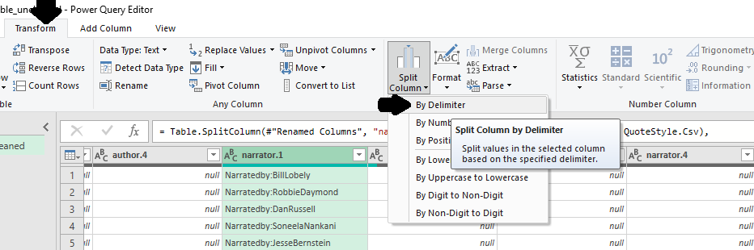
Problem: Split the narratedby column into multiple columns if multiple narrators are listed.
Solution:
Used the 'Split Column by Delimiter' option in Power Query to separate the combined values into individual fields for easier analysis and data handling.
linkedin.com/in/sapna-bhambhwani

Slide 9
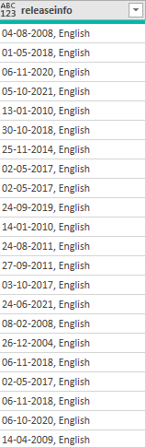
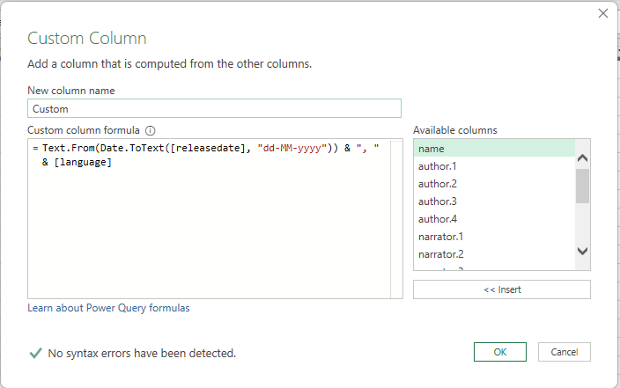
Problem: Merge the releasedate and language columns into a single new column named releaseinfo with the format "DD-MM-YYYY, Language."
Solution:
Added a custom column using the following M query:
ReleaseInfo = Text.From(Date.ToText([releasedate], "dd-MM-yyyy")) & ", " & [language].
The resulting column was then renamed to ReleaseInfo to combine the release date and language into a single, readable format.
linkedin.com/in/sapna-bhambhwani

Slide 10
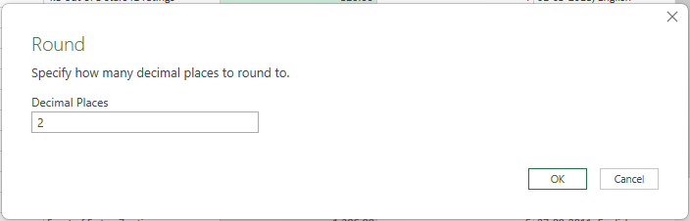
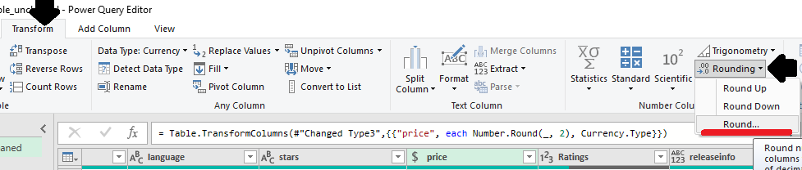
Problem: Ensure all currency values in the price column are formatted consistently with two decimal places.
Solution :
Changed the data type to Currency, then used the 'Round' option from the Transform tab to round the values to 2 decimal places for consistency in financial data representation.
linkedin.com/in/sapna-bhambhwani

Slide 11

Conclusion
Using Power Query in Excel, the Audible dataset was cleaned and standardized by formatting text, splitting and merging columns, converting data types, and ensuring consistency across fields. The result is a structured, analysis-ready dataset suitable for reporting and insights.
Thanks
linkedin.com/in/sapna-bhambhwani

